Slide 1
Data Mining
Laptop price

Slide 2
Agenda
Introduction
Preprocessing
Visualization
k-nearest neighbors algorithm (k-NN)
Support vector machine (SVM)
Linear regression
K-Means Clustering
Naive Bayes
Association Rules

Slide 3
Introduction
Several different factors can affect laptop computer prices. These factors include the brand of computer and the number of options and add-ons included in the computer package. In addition, the amount of memory and the speed of the processor can also affect pricing. Though less common, some consumers spend additional money to purchase a computer based on the overall “look” and design of the system.

Slide 4
Primary goals
Visualize this data, and prepare high-quality charts as much as you can.
Build a model to predict the price.

Slide 5
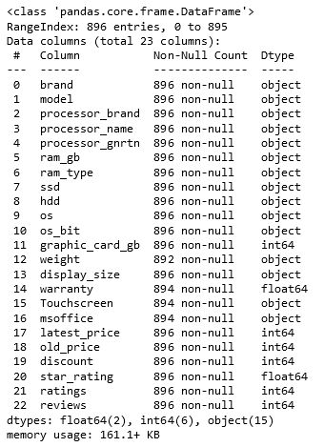
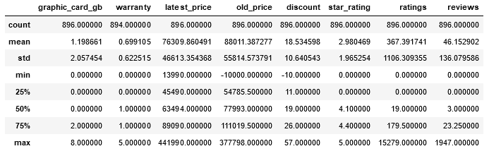
Data.Info() Data.describe()

Slide 6
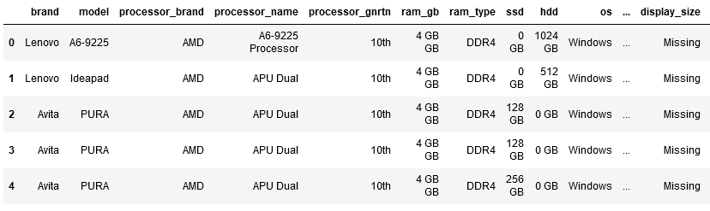
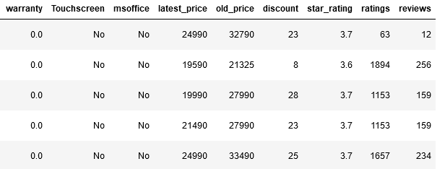
Dataset before preprocessing

Slide 7
Preprocessing
“
”

Slide 8
Preprocessing
Handle missing values :
the value of one column based on another column (relation between columns)
used mode, mean, median and there is more operations we can use it
data reduction:
columns have the same concept like columns star_rating, ratings so we drop one of them
Goal of preprocessing:
have cleaned dataset free from missing values and duplication data

Slide 9
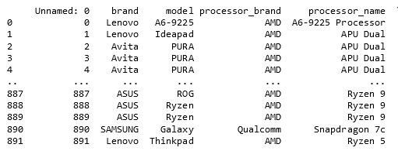
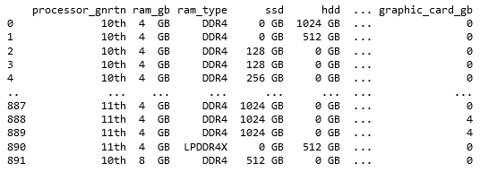
Dataset after preprocessing

Slide 10
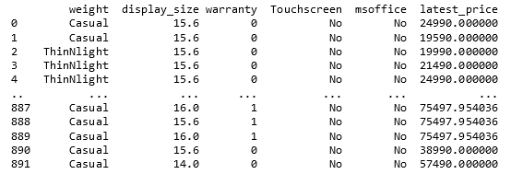
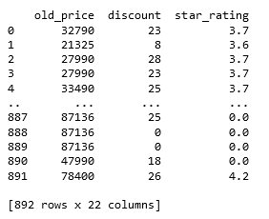
Dataset after preprocessing

Slide 11
Visualization
“
”

Slide 12
Visualization
Is graphical representation for dataset that comes with new information about dataset that were hidden for developers like:
outliers , max-value , min-value , concentration of data.

Slide 13
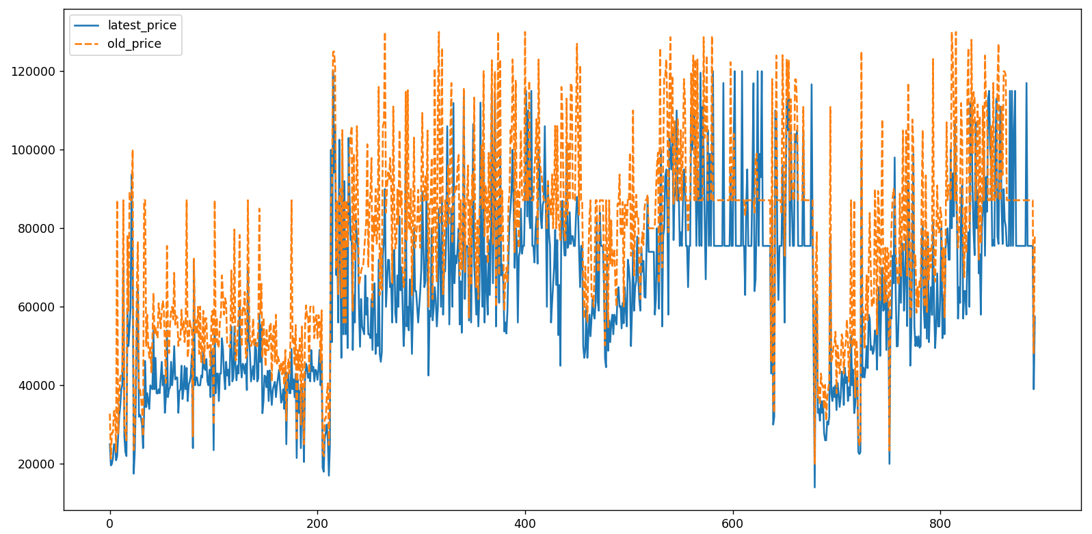
line plot

Slide 14
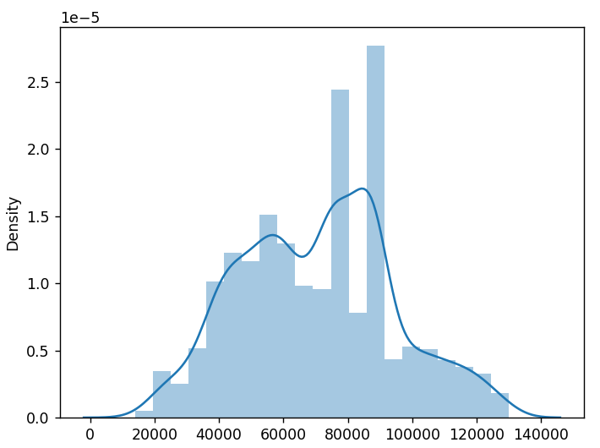
Distplot of price and density

Slide 15
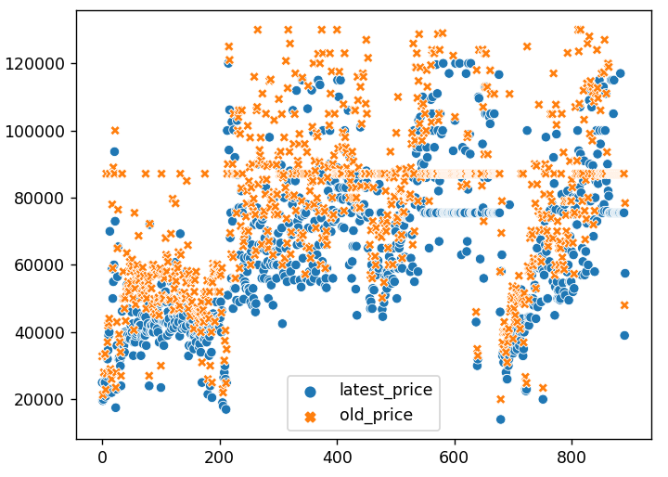
Scatterplot of latest_price and old_price

Slide 16
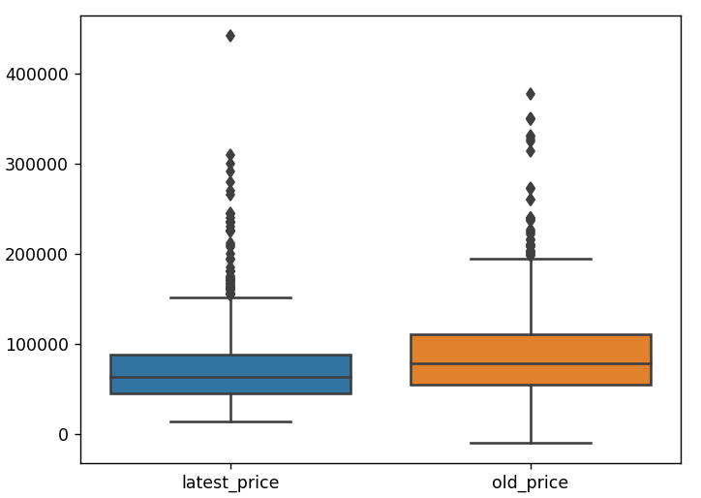
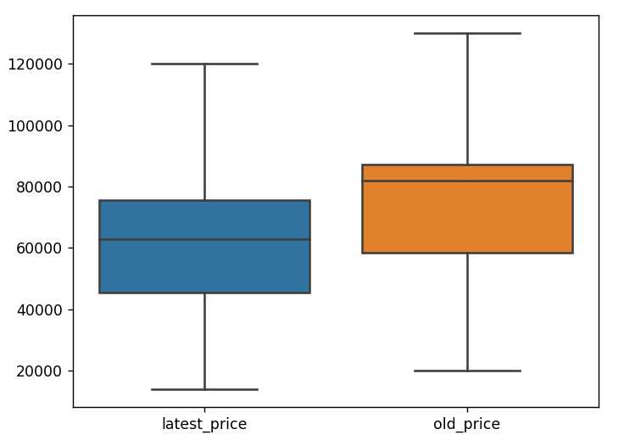
Boxplot to find outliers of data
Before
After

Slide 17
K-Nearest Neighbors (KNN)
“
”

Slide 18
KNN
K-Nearest Neighbors is one of the most basic essential classification algorithms in Machine Learning.
It belongs to the supervised learning domain.
K-NN algorithm can be used for Regression as well as for Classification but mostly it is used for the Classification problems.

Slide 19
Use KNN
When data is labeled
KNN is lazy learner.
lazy learner:
all it is doing is storing the complete data set but it does not do any calculations at this point.
The prediction step in K-NN is expensive. Each time we want to make a prediction, K-NN is searching for the nearest neighbors in the entire training set.

Slide 20
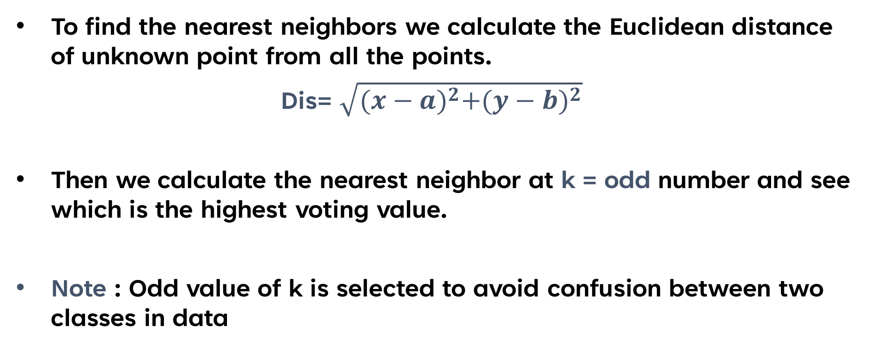
How we choose k ?
To find the nearest neighbors we calculate the Euclidean distance of unknown point from all the points.
Dis= $\sqrt{{(x−a)}^{2}+{(y−b)}^{2}}$
Then we calculate the nearest neighbor at k = odd number and see which is the highest voting value.
Note : Odd value of k is selected to avoid confusion between two classes in data

Slide 21
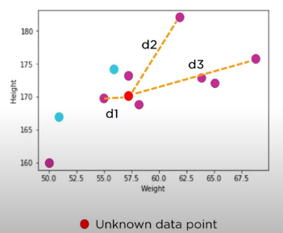
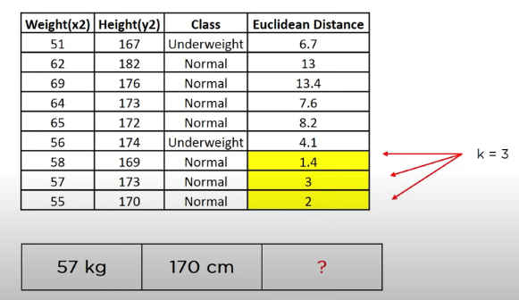
Let’s Have a look :

Slide 22
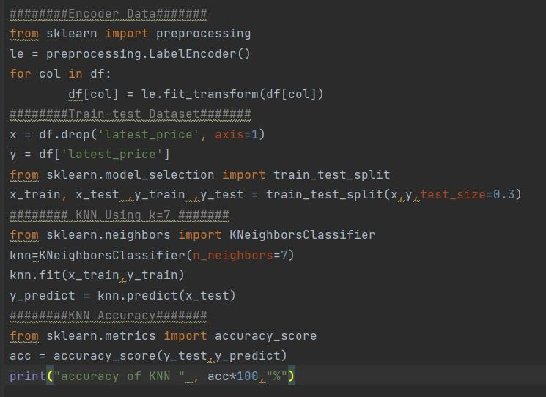
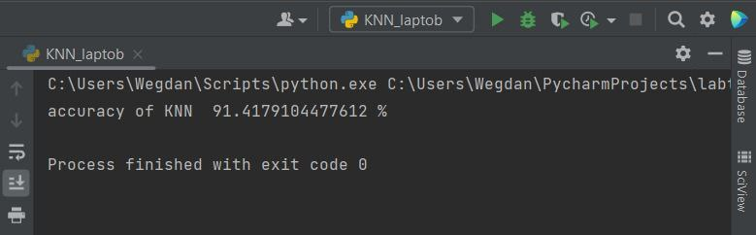
Coding of KNN

Slide 23
Support vector machine (SVM)
“
”

Slide 24
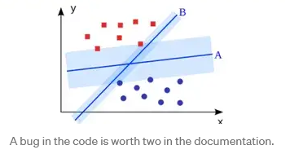
SVM
discriminative classifier formally defined by a separating hyperplane.
In two dimensional space this hyperplane is a line dividing a plane in two parts where in each class lay in either side.

Slide 25
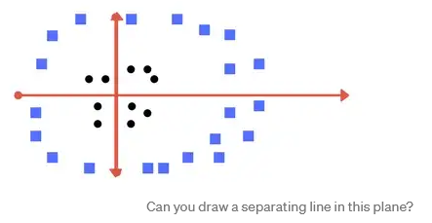
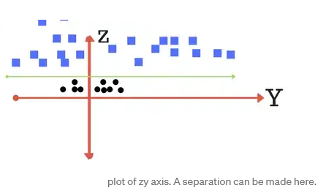
Making it a Bit complex

Slide 26
Making it a Bit complex

Slide 27
Kernel
For linear kernel the equation for prediction for a new input using the dot product between the input (x) and each support vector (xi) is calculated as follows:
f(x) = B(0) + sum(ai * (x,xi))
The polynomial kernel can be written as K(x,xi) = 1 + sum(x * xi)^d and exponential as K(x,xi) = exp(-gamma * sum((x — xi²)). [Source for this excerpt
Polynomial and exponential kernels calculates separation line in higher dimension is kernel trick.

Slide 28
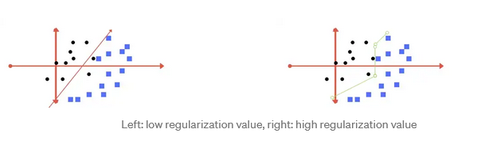
Regularization
C parameter in python’s sklearn library) tells the SVM optimization how much you want to avoid misclassifying each training example.

Slide 29
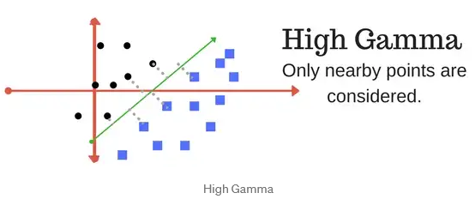
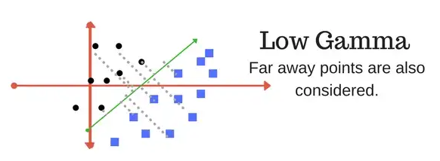
Gamma
The gamma parameter defines how far the influence of a single training example reaches, with low values meaning ‘far’ and high values meaning ‘close’.

Slide 30
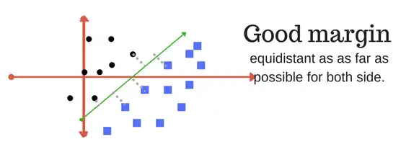
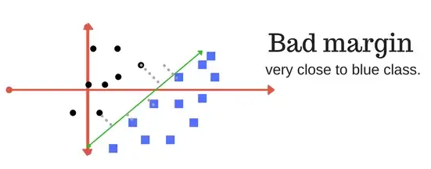
Margin
A margin is a separation of line to the closest class points.

Slide 31
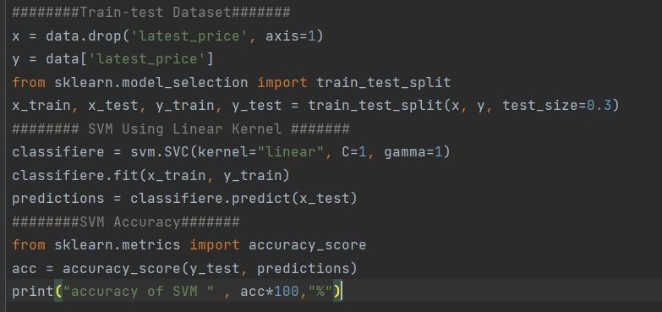
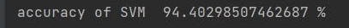
Coding of SVM

Slide 32
Difference Between KNN and SVM
The KNN however, used as system of voting to determine which class an unclassified object belongs to, considering the class of the nearest neighbors in the input space. The SVM is extremely fast, classifying images in roughly ten seconds as opposed to the KNN which takes anywhere from forty to fifty seconds to classify the same image.

Slide 33
K-Means Clustering
“
”

Slide 34
K-means
K-means clustering is one of the simplest and popular unsupervised classification machine learning algorithms.
unsupervised algorithms make inferences from datasets using only input vectors without referring to known, or labelled, outcomes.
the K-means algorithm in data mining starts with a first group of randomly selected centroids

Slide 35
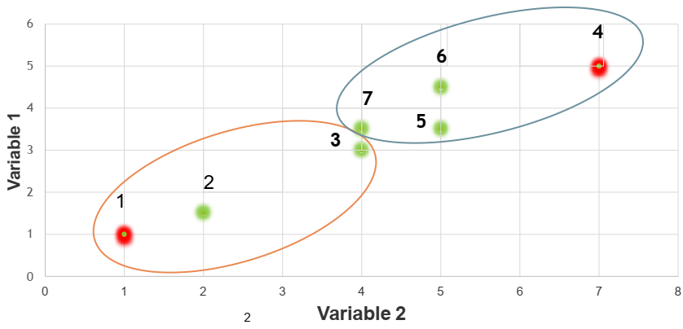
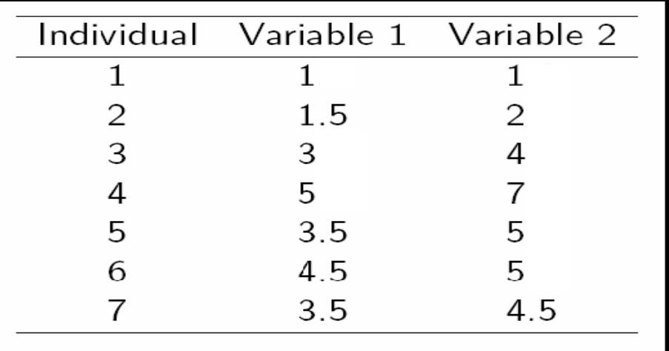
A Simple example k-means (using K=2)

Slide 36
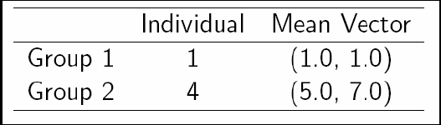
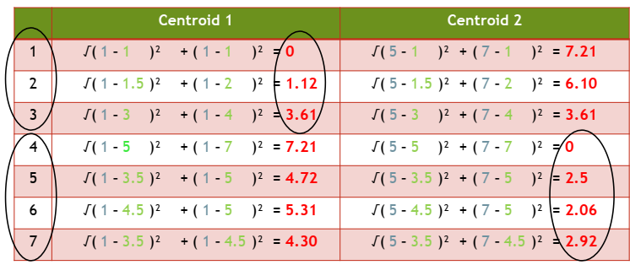
Step 1 :
Initialization: Randomly we choose following two centroids (k=2) for two clusters.
Step 2 :

Slide 37
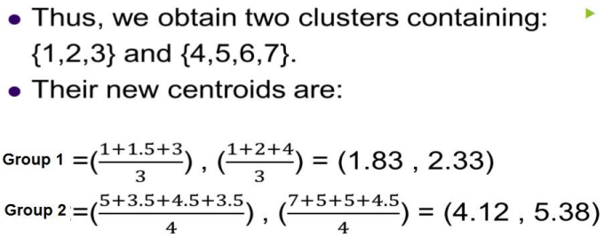
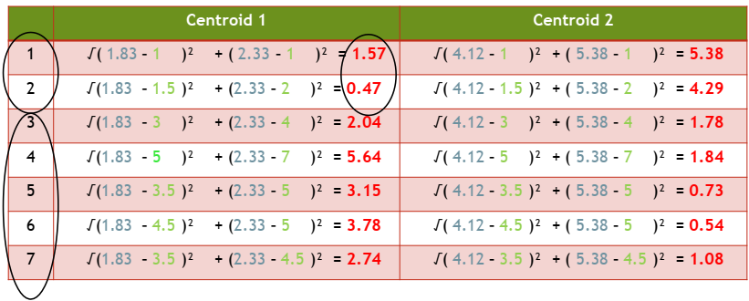
Step 2 :
Step 3 :

Slide 38
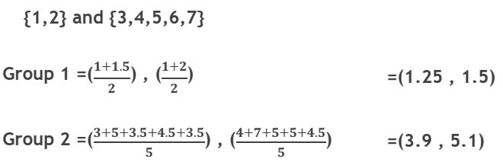
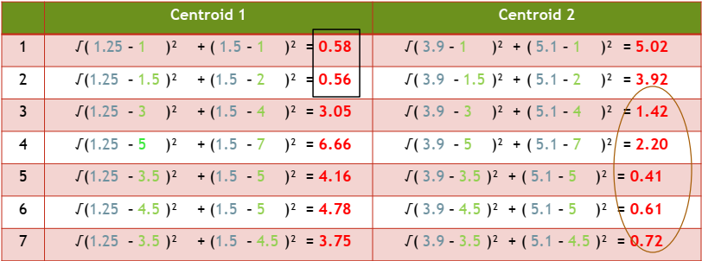
Therefore, the new clusters are:
Step 4 :

Slide 39
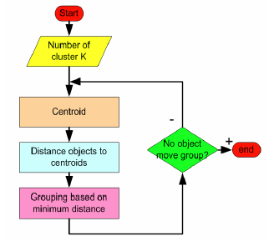
K-means
Therefore, there is no change in the cluster.
Thus, the algorithm comes to a halt here and final result consist of 2 clusters {1,2} and {3,4,5,6,7}.
How the K-Mean Clustering algorithm works?

Slide 40
Linear Regression
“
”

Slide 41
Linear Regression
Linear Regression is a machine learning algorithm based on supervised learning that makes predictions for continuous/real or numeric variables.
Linear regression performs the task to predict a dependent variable value (y) based on a given independent variable (x).
It also reveals the correlation between a dependent variable (output) and one or more independent variable (input).

Slide 42
Types of linear Regression
Simple Linear Regression: If a single independent variable is used to predict the value of a numerical dependent variable, then such a Linear Regression algorithm is called Simple Linear Regression.
Multiple Linear regression: If more than one independent variable is used to predict the value of a numerical dependent variable, then such a Linear Regression algorithm is called Multiple Linear Regression.

Slide 43
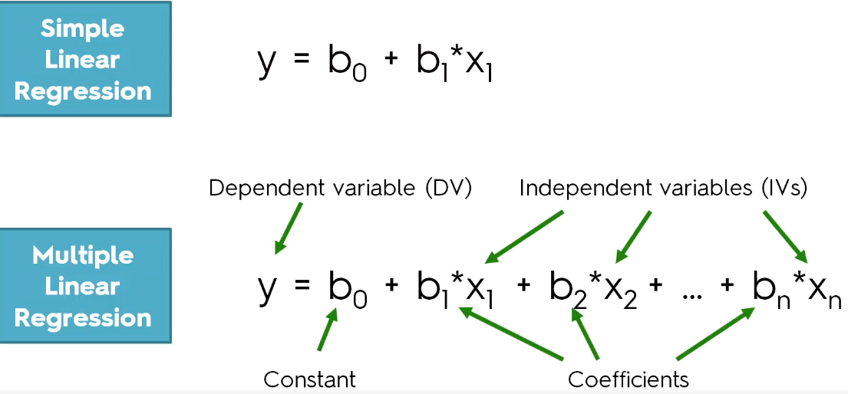
Mathematically, we can represent a linear regression as:

Slide 44
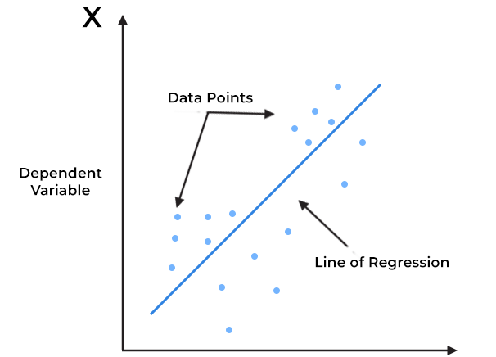
The best fit line
When working with linear regression our main goal is to find the best fit line that means the error between predicted values and actual values should be minimized. The best fit line will have the least error.

Slide 45
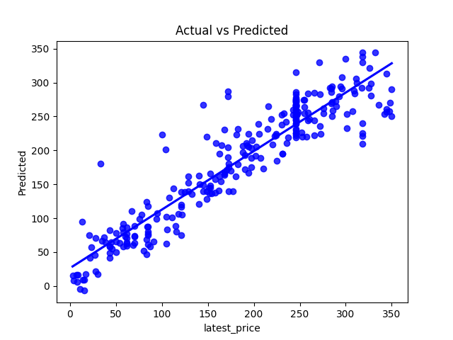
Linear Regression on laptop dataset

Slide 46
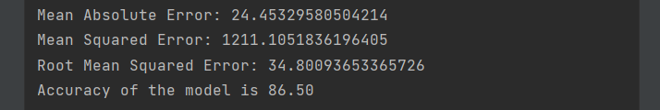
Cost function & performance measure

Slide 47
Naive Bayes
“
”

Slide 48
Naive Bayes
Machine learning algorithm to solve classification problems based on the Bayes Theorem.
It is one of the simplest yet powerful ML algorithms in use and finds applications in many industries.
It is quite faster in comparison to other classification algorithms.

Slide 49
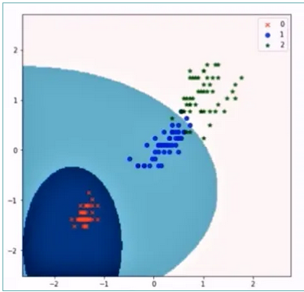
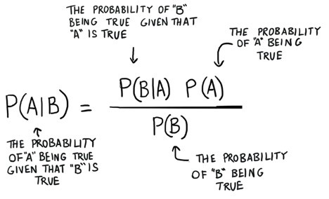
Naive Bayes
All predictors are independent, this classifier assumes that the presence of one particular feature in a class doesn’t affect the presence of another one.

Slide 50
Types Of Naive Bayes Algorithm
Gaussian Naive Bayes Algorithm – It is used to normal classification problems.
Multinomial Naive Bayes Algorithm – It is used to classify on words occurrence.
Bernoulli Naive Bayes Algorithm – It is used to binary classification problems.

Slide 51
Usage Of Naive Bayes Algorithm:
News Classification.
Spam Filtering.
Face Detection / Object detection.
Medical Diagnosis.
Weather Prediction, etc.

Slide 52
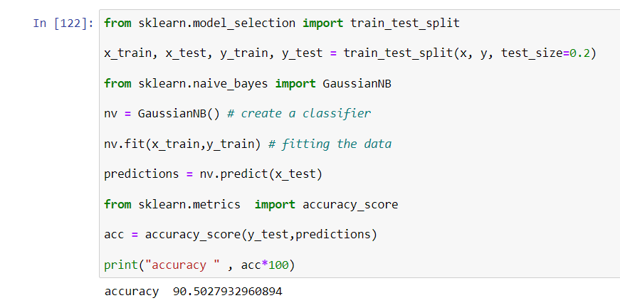
Coding

Slide 53
Association Rules
“
”

Slide 54
Association Rules
Association Rule Learning is type of Unsupervised Learning that is one of the useful techniques in data mining and knowledge discovery that extracts interesting relationships between items in datasets.
Applications of Association Rules :
Market-basket analysis is one of the most intuitive applications.
Recommendation Systems.

Slide 55
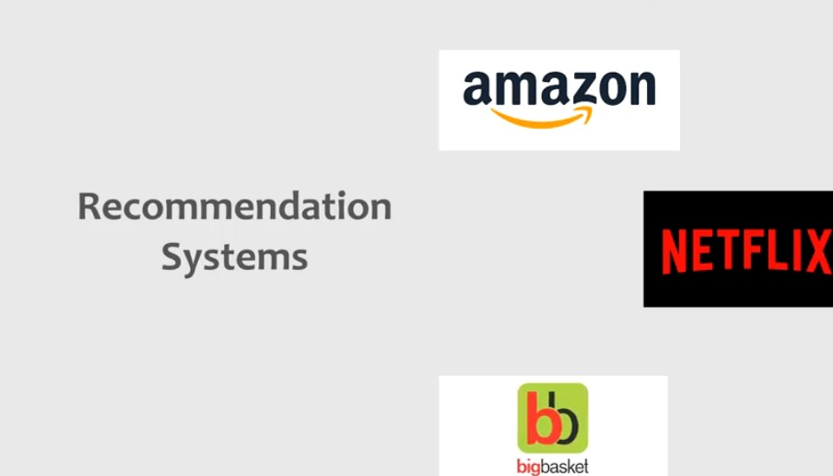

Slide 56
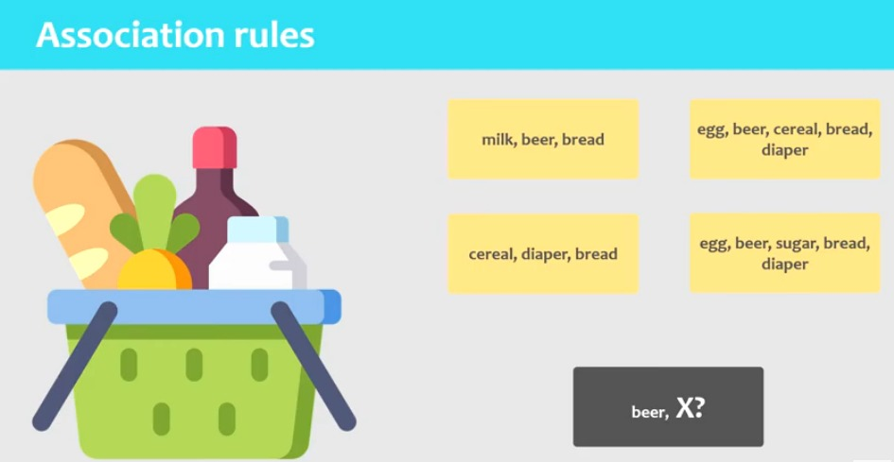

Slide 57
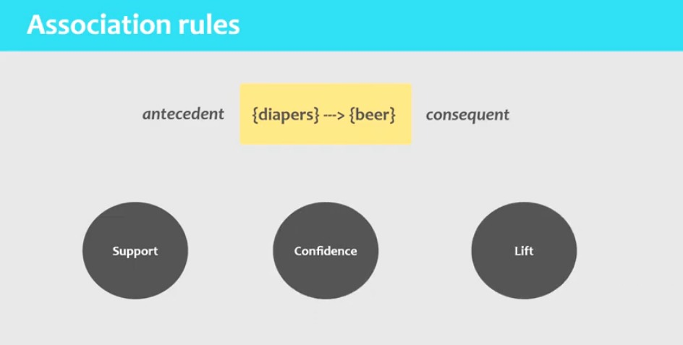
Association Rules computes three measure metrics.

Slide 58
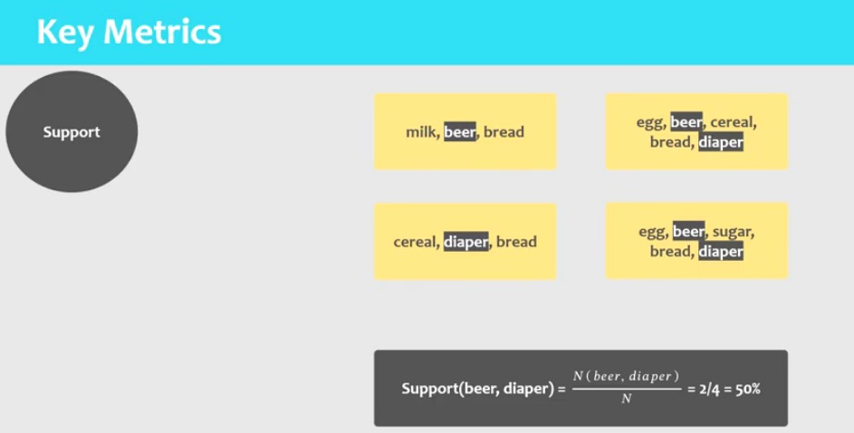
Support: frequency of occurrence of an itemset as a percentage of all transactions

Slide 59
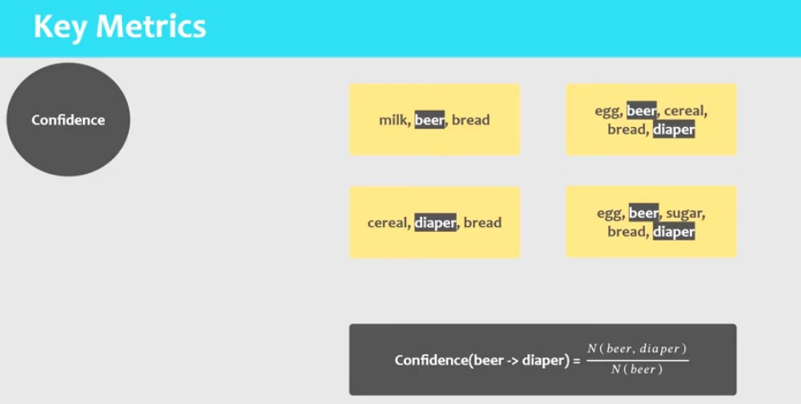
Confidence: measures of how often items in y appear in transaction of other item.

Slide 60
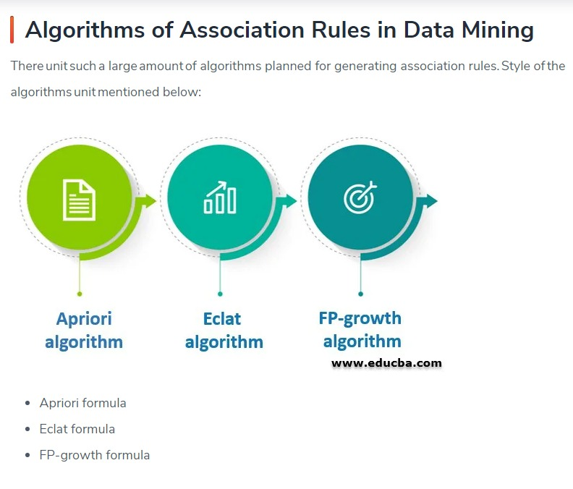

Slide 61


Slide 62


Slide 63

Suppose that we will replace {B,C,E} by {milk , bread , egg}

Slide 64


Slide 65


Slide 66
Logistic Regression
“
”

Slide 67
Logistic Regression
Logistic regression is a fundamental classification technique. It belongs to the group of linear classifiers and is somewhat similar to polynomial and linear regression.
Logistic regression is fast and relatively uncomplicated, and it’s convenient for you to interpret the results. Although it’s essentially a method for binary classification, it can also be applied to multiclass problems.

Slide 68

Logistic and Linear Regression

Slide 69

Sigmoid function

Slide 70


Slide 71



Cost Function :
Gradient Descent :
Accuracy score :

Slide 72
Decision tree
“
”

Slide 73
Decision tree
Decision Tree algorithm belongs to the family of supervised learning algorithms.
Decision tree algorithm can be used for solving regression and classification problems too ,as it has 2 Types(Classification decision tree, Regression Decision Tree)
The Goal Of Decision Tree
The goal of using a Decision Tree is to create a training model that can use to predict the class or value of the target variable by learning simple decision rules

Slide 74

How Decision Tree Works

Slide 75

Attribute Selection Criterion
For categorical target use:
- Entropy , Information Gain
- Gini Index
For continues target use:
- Squared error
- Absolute error

Slide 76

Entropy measures impurity in the data and information gain measures reduction in impurity in the data.
Entropy(Parent)

Slide 77



Information Gain measures the expected reduction in entropy.
The feature which has maximum information gain will be considered as the root node

Slide 78

The Gini index can also be used for feature selection.
The Gini Index or Impurity measures the probability for a random instance being misclassified when chosen randomly.
The tree chooses the feature that minimizes the Gini impurity index.

Slide 79


Slide 80

Regression Decision Tree

Slide 81
Comparison
Algorithm | Type | Purpose | Accuracy
KNN | Supervised | Classification | 91.5 %
SVM | Supervised | Classification | 94.4 %
Linear Regression | Supervised | Regression | 86.5 %
K-Means Clustering | Unsupervised | Clustering | -
Naïve Bayes | Supervised | Classification | 90.5 %
Association Rules | Unsupervised | Classification | -
Logistic regression | Supervised | Classification | 89 %
Decision tree | Supervised | Classification/Regression | 84.02 %

Slide 82


